Slide 1
Policy Recommendations
Human Protection
Full access to basic healthcare
Housing Allowances
GDP
Access to work
Startup grants
Access to Job
Hiring test
Freedom to Move
Access to Education
Wage subsity policy
Language Training
Vocational Training
Early working permit

Slide 2
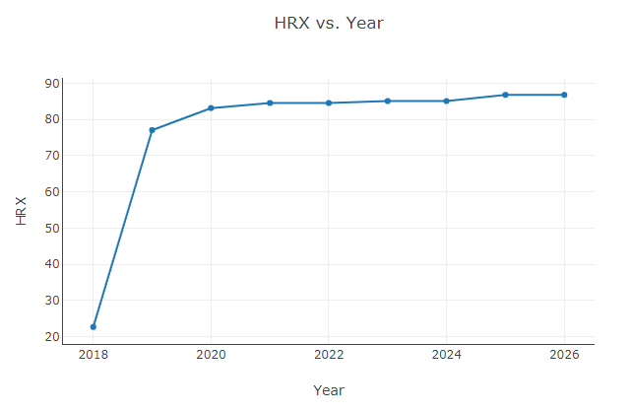
Policy Impacts

Slide 3
Policy Impacts

Slide 4
Policy Impacts

Slide 5
Policy Impacts

Slide 6
